Slide 1
Control statements
Control statements enable us to specify the order in which the various instructions in the program are to be executed. They define how the control is transferred to other parts of the program.

Slide 2
Introduction
In C programs, statements are executed sequentially in the order in which they appear in the program.
But sometimes we may want to use a condition for executing only a part of program.
Also many situations arise where we may want to execute some statements several times.
Control statements enable us to specify the order in which the various instructions in the program are to be executed.

Slide 3
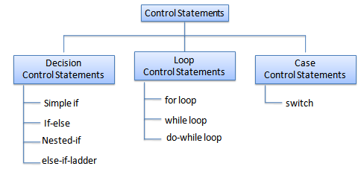
Types
This determines the flow of control. Control statements defines how the control is transferred to other parts of the program.

Slide 4
Control statements
Non-iterative
iterative
conditional
un-conditional
conditional
un-conditional
if
break
goto
for
if-else
continue
while
nested if
return
do-while
else-if ladder
switch

Slide 5
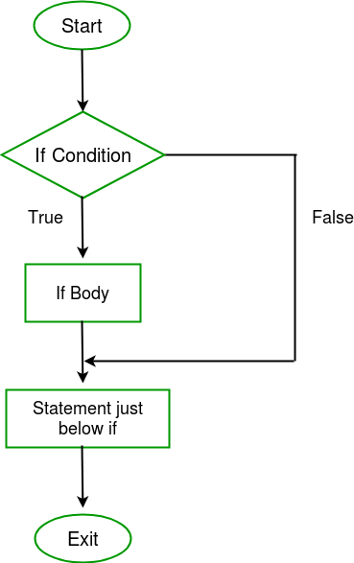
Flow chart :
If condition
Syntax :
if(condition)
{
.......
.......
.......
}
Note : if condition is true, then it will treat that condition value
as 1 and execute the statement.
But if condition is false,
then it will treat that value as 0 and will not execute the statements.

Slide 6
Example :
If condition
#include<stdio.h>
int main()
{
int i = 10;
if (i > 15)
{
printf("i is greater than 15\n");
}
printf("I am Not in if\n");
}
Output :
I am Not in if

Slide 7
If-else condition
Syntax :
if(test_expression)
{
//execute your code
}
else
{
//execute your code
}
Description :
If-else statements in C is also used to control the program flow based on some condition, only the difference is, it is used to execute some statement code block if the expression is evaluated to true, otherwise executes else statement code block.

Slide 8
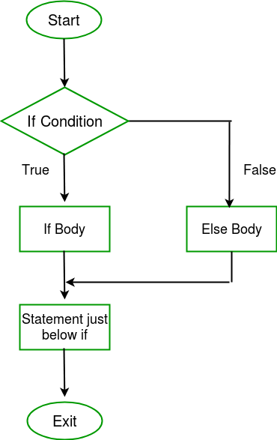
If-else condition
Flow chart :

Slide 9
Example :
If-else condition
#include<stdio.h>
int main()
{
int i = 20;
if (i < 15)
printf("i is smaller than 15\n");
else
printf("i is greater than 15\n");
return 0;
}
Output:
i is greater than 15

Slide 10
if-else condition
#include<stdio.h>
int main()
{
int i=10;
if(i>15) {
printf("Hello\n");
printf("i is greater than 15\n");
}
else {
printf("Hai...\n");
printf("i is smaller than 15\n");
}
printf("I am not in if\n");
}

Slide 11
else without if leads error
#include<stdio.h>
int main()
{
else
{
printf("Hai...\n");
printf("i is smaller than 15\n");
}
printf("I am not in if\n");
}
Note : for if part, else part is not mandatory, but for else part, if part is mandatory.

Slide 12
If condition with ; colon
#include<stdio.h>
int main()
{
int x = 10;
if(x < 5);
{
printf("Hello\n");
printf("Hai\n");
}
printf("I am not in if\n");
}

Slide 13
Statement in the middle of if-else is invalid
#include<stdio.h>
int main()
{
int x = 10;
if(x < 20)
printf("x is smaller than 20\n");
printf("Hello...\n");
else
printf("x is greater than 20\n");
}
Note : No statements should be provided b/w if-else parts.
Here,
printf("Hello...\n") is the statement b/w if-else parts is invalid.

Slide 14
Multiple statements of if-else must be in { … }
#include<stdio.h>
int main()
{
int x = 10;
if(x < 20)
{
printf("x is smaller than 20\n");
printf("Hello...\n");
}
else
printf("x is greater than 20\n");
}

Slide 15
If condition with semicolon (;)
#include<stdio.h>
int main()
{
int x = 10;
if(x < 20);
{
printf("x is smaller than 20\n");
printf("Hello...\n");
}
else
printf("x is greater than 20\n");
}
Output : else part is not under if part
if(x < 20)
; //here ; is dummy statement
{
printf("x is smaller than 20\n");
printf("Hello...\n");
}
else
printf("x is greater than 20\n");

Slide 16
If condition with multiple expressions
#include<stdio.h>
int main()
{
int x = 10;
if(x < 20, x != 10, x == 10)
{
printf("x is smaller than 20\n");
printf("Hello...\n");
}
else
printf("x is greater than 20\n");
}
Note : Right most expression is the condition when multiple expressions are there in if condition.

Slide 17
Right most expression as condition in if part
#include<stdio.h>
int main()
{
int i = 14;
if(i > 15, i < 12, i++, i == 15)
printf("if part is true...\n");
else
printf("else part...\n");
}

Slide 18
Right most expression as condition in if part
#include<stdio.h>
int main()
{
int i = 14;
if(i < 15, i < 20, i++, i == 14)
printf("if part is true...\n");
else
printf("else part...\n");
}

Slide 19
Nested-if condition
if(test_expression one)
{
if(test_expression two)
{
//Statement block Executes
}
}
else {
//stataments for else
}
Description : Nested if else statements play an important role in C programming, it means you can use conditional statements inside another conditional statement.

Slide 20
Example :
Nested-if condition
#include<stdido.h>
int main()
{
int i = 10;
if (i == 10)
{
if (i < 15)
printf("i is smaller than 15\n");
if (i < 12)
printf("i is smaller than 12 too\n");
else
printf("i is greater than 15");
}
}
Output :
i is smaller than 15
i is smaller than 12 too

Slide 21
else-if ladder condition
if(test_expression)
{
//execute your code
}
else if(test_expression n)
{
//execute your code
}
else
{
//execute your code
}
Description :
else-if statements in C is like another if condition, it's used in a program when if statement having multiple decisions.

Slide 22
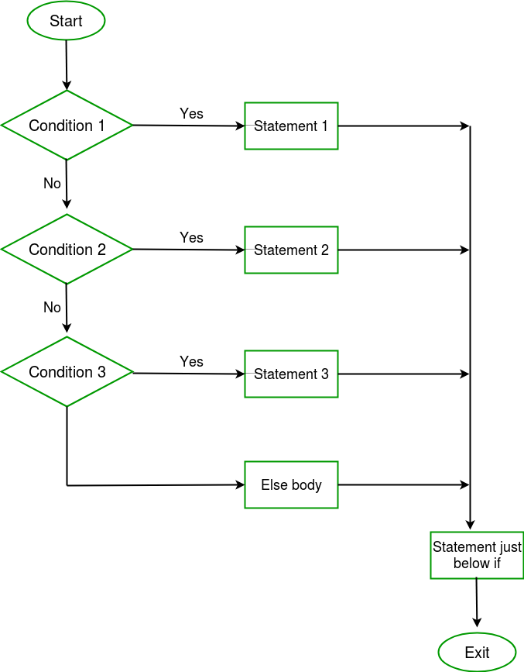
else-if ladder condition

Slide 23
Example :
else-if ladder Condition
#include<stdio.h>
int main()
{
int i = 20;
if (i == 10)
printf("i is 10");
else if (i == 15)
printf("i is 15");
else if (i == 20)
printf("i is 20");
else
printf("i is not present");
}
Output :
i is 20

Slide 24
big data variable among 2 variable (x,y)
#include<stdio.h>
int main()
{
int x,y;
printf("Enter the x,y values\n");
scanf("%d%d",&x,&y);
if(x < y)
printf("y is big\n");
else if(x > y)
printf("x is big\n");
else
printf("x,y are equal\n");
}

Slide 25
Big data variable among 3 variable (x,y,z)
#include<stdio.h>
int main()
{
int x,y,z;
printf("Enter the x,y,z values\n");
scanf("%d%d%d",&x,&y,&z);
if( (x < z)&&(y < z) )
printf("z is greater\n");
else if( (x < y)&&(z < y) )
printf("y is greater\n");
else if( (y < x)&&(z < x) )
printf("x is greater\n");

Slide 26
Big data variable among 3 variable (x,y,z)
else if( (y == z)&&(x < y) )
printf("y,z are equal & greater than x\n");
else if( (x == y)&&(z < x) )
printf("x,y are equal & greater than z\n");
else if( (x == z)&&(y < z) )
printf("x,z are equal & greater than y\n");
else
printf("x,y,z are equal\n");
}

Slide 27
Program to check type of given character
#include<stdio.h>
int main()
{
char ch;
printf("Enter the char\n");
scanf("%c",&ch)
if((ch>='A')&&(ch<='Z'))
printf("Upper case Alphabet\n");
else if((ch>='a')&&(ch<='z'))
printf("Lower case Alphabet\n");
else if((ch>='0')&&(ch<='9'))
printf("Digit\n");
else
printf("Special character\n");
}

Slide 28
Convertion of alphabet into it’s opposite case
#include<stdio.h>
int main()
{
char ch;
printf("Enter the char\n");
scanf("%c",&ch);
if( ( (ch>='A')&&(ch<='Z') ) || ( (ch>='a')&&(ch<='z') ) )
{
ch = ch^32;
printf("after conversion, ch = %c\n",ch);
}
else
printf("not an alphabet\n");
}

Slide 29
return ---> immediate exit from the function
#include<stdio.h>
int main()
{
printf("Hello...\n");
return 0;
printf("Vector\n");
printf("India\n");
printf("Chennai\n");
printf("Embedded\n");
}

Slide 30
Basic calculator prog using else-if
#include<stdio.h>
int main()
{
char op;
int x,y,z;
printf("Enter the x,y values\n");
scanf("%d%d",&x,&y);
printf("Enter the operator '+','-','*','/','%%'\n");
scanf(" %c",&op);
if(op == '+')
z = x+y;
else if(op == '-')
z = x-y;

Slide 31
Basic calculator prog using else-if
else if(op == '*')
z = x*y;
else if(op == '/')
z = x/y;
else if(op == '%')
z = x%y;
else {
printf("Invalid operator...\n");
return 0;
}
printf("%d %c %d = %d\n",x,op,y,z);
}

Slide 32
Switch case Syntax :
switch (n)
{
case 1: // code to be executed if n = 1;
break;
case 2: // code to be executed if n = 2;
break;
-------------
--------------
--------------
case n : // code to be executed
default: // code to be executed if n doesn't match any cases
}

Slide 33
Switch Statement in C

Slide 34
Switch case description
Switch case statements are a substitute for long if statements that compare a variable to several integral values.
The switch statement is a multi way branch statement. It provides an easy way to dispatch execution to different parts of code based on the value of the expression.
Switch is a control statement that allows a value to change control of execution.

Slide 35
Restrictions of switch cases :
1. The switch case statements must be either integer constant or char constant only.
2. switch case labels should not be
Variables,
Floating point numbers,
Strings,
Duplicate cases.
3. break is keyword should be used for switch cases to execute only the particular cases.
4. if there is no break, then the control is automatically falls to the next cases for execution until there is break found.

Slide 36
Example on switch
#include<stdio.h>
int main( )
{
int op;
printf("Enter the option\n"); scanf("%d",&op);
switch(op)
{
case 1: printf("case-1\n"); printf("Hello...\n"); break;
case 2: printf("case-2\n"); printf("Hai...\n"); break;
case 3: printf("case-3\n"); printf("bye...\n"); break;
default: printf("default...\n");
printf("options other than 1,2 & 3\n");
}
}

Slide 37
Basic calculator program using switch
#include<stdio.h>
int main()
{
char op;
int x,y,z;
printf("Enter the x,y values\n");
scanf("%d%d",&x,&y);
printf("Enter the operator '+','-','*','/','%%'\n");
scanf(" %c",&op);

Slide 38
Basic calculator program using switch
switch(op)
{
case '+': z = x+y; break;
case '-': z = x-y; break;
case '*': z = x*y; break;
case '/': z = x/y; break;
case '%': z = x%y; break;
default : printf("Invalid option...\n");
return 0;
}
printf("%d %c %d = %d\n",x,op,y,z);
}

Slide 39
Switch cases without break statement
#include<stdio.h>
int main()
{
int op = 1, x = 2, y = 3;
switch(op)
{
case 1 : x += y;
case 2 : x *= y;
case 3 : x -= y;
default : x -= 2;
}
printf("x = %d y = %d\n",x,y);
}

Slide 40
Switch case example
#include<stdio.h>
int main()
{
int op = 2;
switch(op)
{
case 3 : printf("case 3...\n"); break;
case 1 : printf("case 1...\n"); break;
case 2 : printf("case 2...\n"); break;
}
}
Note : switch case accepts the different sequence of case labels.

Slide 41
Duplicate cases are invalid in switch
#include<stdio.h>
int main()
{
char op = 'A';
switch(op)
{
case 'A' : printf("case - A\n"); break;
case 65 : printf("case 65\n"); break;
case 97 : printf("case 97\n"); break;
}
}
Note : The switch case doesn't accept the duplicate cases.

Slide 42
Switch case example
#include<stdio.h>
int main()
{
int x = 2;
switch(2)
{
case 2 : printf("Hello\n"); break;
case '2': printf("Hai\n"); break;
}
}

Slide 43
Switch case restrictions
#include<stdio.h>
int main()
{
int x = 2;
switch(x)
{
case 1 : printf("Hello\n"); break;
//case x : printf("Hai\n"); break; //error
//case 2.0 : printf("Hai\n"); break; //error
//case "2" : printf("Hai\n"); break; //error
//case 2 : printf("Hai\n"); break;
case 1+1 : printf("Bye\n"); break; //error
}
}

Slide 44
Jump Statements in C
goto
break
continue
return
C goto :
The goto statement in C also referred to as unconditional jump statement can be used to jump from one point to another within a function.
There are 2 types of goto statements.
1. forward goto
2. backward goto

Slide 45
goto Statement in C
forward goto | backward goto
------------------------------
goto label; | label:
. | .
. | .
. | .
label: | goto label;
Description :
the statement goto label; tells the compiler to go to or jump to the statement marked as a label. Here label is a user-defined identifier which indicates the target statement.
The statement immediately followed after ‘label:’ is the destination statement.
The ‘label:’ can also appear before the ‘goto label;

Slide 46
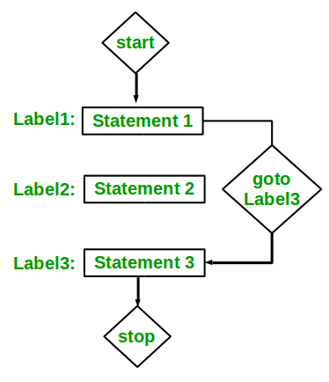
Flow chart :
goto Statement in C

Slide 47
Example :
goto Statement in C
int main()
{
printf ( “hello\n” ) ;
label: printf ( “hi\n”) ;
ptrintf ( “goto test\n” ) ;
goto label;
printf (“after goto\n”);
}
Output :
Hello
hi
goto test
hi
goto test
.
.
.

Slide 48
Forward goto example
#include<stdio.h>
int main()
{
printf("Hello...\n");
goto label;
printf("Hai...\n");
printf("Vector...\n");
printf("India...\n");
label:
printf("Embedded...\n");
printf("Training...\n");
printf("Chennai...\n");
}

Slide 49
Backward goto example
#include<stdio.h>
#include<unistd.h>
int main()
{
printf("Hello...\n");
abc:
printf("Hai...\n");
printf("Vector...\n");
printf("India...\n");
sleep(1);
goto abc;
printf("Embedded...\n");
printf("Training...\n");
printf("Chennai...\n");
}

Slide 50
Printing “Hello world” for 10 times
#include<stdio.h>
int main()
{
int i=0;
abc:
printf("Hello world\n");
i++;
if(i<10)
goto abc;
}

Slide 51
Multiplication table for given number
#include<stdio.h>
int main()
{
int i=1,n;
printf("Enter the n value\n");
scanf("%d",&n);
label:
printf("%d * %d = %d\n",n,i,n*i);
i++;
if(i<=10)
goto label;
printf("\n");
}

